Slide 1

BELLEBEAT FITNESS CASE STUDY
PRESENTED BY
H.ANANTHARAMAN

Slide 2
Agenda
Introduction
Objective
Data Integrity
Data Cleaning and Manipulation
Analysis
Conclusions
Recommendations

Slide 3
Introduction
URŠKA SRŠEN AND SANDO MUR FOUNDED BELLABEAT, A HIGH-TECH COMPANY THAT MANUFACTURES HEALTH-FOCUSED SMART PRODUCTS. SRŠEN USED HER BACKGROUND AS AN ARTIST TO DEVELOP BEAUTIFULLY DESIGNED TECHNOLOGY THAT INFORMS AND INSPIRES WOMEN AROUND THE WORLD. COLLECTING DATA ON ACTIVITY, SLEEP, STRESS, AND REPRODUCTIVE HEALTH HAS ALLOWED BELLABEAT TO EMPOWER WOMEN WITH KNOWLEDGE ABOUT THEIR OWN HEALTH AND HABITS. SINCE IT WAS FOUNDED IN 2013, BELLABEAT HAS GROWN RAPIDLY AND QUICKLY POSITIONED ITSELF AS A TECH-DRIVEN WELLNESS COMPANY FOR WOMEN.
BY 2016, BELLABEAT HAD OPENED OFFICES AROUND THE WORLD AND LAUNCHED MULTIPLE PRODUCTS. BELLABEAT PRODUCTS BECAME AVAILABLE THROUGH A GROWING NUMBER OF ONLINE RETAILERS IN ADDITION TO THEIR OWN E-COMMERCE CHANNEL ON THEIR WEBSITE. THE COMPANY HAS INVESTED IN TRADITIONAL ADVERTISING MEDIA, SUCH AS RADIO, OUT-OF-HOME BILLBOARDS, PRINT, AND TELEVISION, BUT FOCUSES ON DIGITAL MARKETING EXTENSIVELY. BELLABEAT INVESTS YEAR-ROUND IN GOOGLE SEARCH, MAINTAINING ACTIVE FACEBOOK AND INSTAGRAM PAGES, AND CONSISTENTLY ENGAGES CONSUMERS ON TWITTER. ADDITIONALLY, BELLABEAT RUNS VIDEO ADS ON YOUTUBE AND DISPLAY ADS ON THE GOOGLE DISPLAY NETWORK TO SUPPORT CAMPAIGNS AROUND KEY MARKETING DATES.
SRŠEN KNOWS THAT AN ANALYSIS OF BELLABEAT’S AVAILABLE CONSUMER DATA WOULD REVEAL MORE OPPORTUNITIES FOR GROWTH. SHE HAS ASKED THE MARKETING ANALYTICS TEAM TO FOCUS ON A BELLABEAT PRODUCT AND ANALYZE SMART DEVICE USAGE DATA IN ORDER TO GAIN INSIGHT INTO HOW PEOPLE ARE ALREADY USING THEIR SMART DEVICES. THEN, USING THIS INFORMATION, SHE WOULD LIKE HIGH-LEVEL RECOMMENDATIONS FOR HOW THESE TRENDS CAN INFORM BELLABEAT MARKETING STRATEGY.

Slide 4
OBJECTIVE
TO ANALYZE SMART DEVICE USAGE DATA IN ORDER TO GAIN INSIGHTS INTO HOW CONSUMERS USE NON-BELLABEAT SMART DEVICES AND THEN SELECT ONE BELLABEAT PRODUCT TO APPLY THESE INSIGHTS.

Slide 5
DATA INTEGRITY
DATA SOURCE : 30 PARTICIPANTS FITNESS FITBIT DATA FROM MOBIUS.
THERE ARE 18 CSV FILES ASSOCIATED WITH THE DATA.
THE DATA FOLLOWS A ROCCC APPROACH.
RELIABILITY : THIRTY ELIGIBLE FITBIT USERS CONSENTED TO THE SUBMISSION OF PERSONAL TRACKER DATA, INCLUDING MINUTE-LEVEL OUTPUT FOR PHYSICAL ACTIVITY, HEART RATE, AND SLEEP MONITORING.
ORIGINAL : THE DATA IS FROM THE 30 FITBIT USERS WHO CONSENTED TO THE SUBMISSION OF PERSONAL TRACKER DATA VIA AMAZON MECHANICAL TURK SURVEY.
COMPRHENSIVE : THE DATA IS COMPREHENSIVE IN TERMS OF BEING MEANINGFUL, EASY TO UNDERSTAND AND READABLE. THERE IS NOT MUCH OF DATA AVAILABLE AS WELL AS THE DATA IS INCOMPLETE.
CURRENT : THE GIVEN DATA IS FROM MARCH 2016 TO MAY 2016 AND IT IS A OLD DATA.
CITED : UNKNOWN

Slide 6
DATA CLEANING AND MANIPULATION
DATA CLEANING :
AFTER HAVING EXPLORED THE GIVEN CSV FILES THERE WERE SOME DATA QUALITY ISSUES THAT HAD TO BE ADDRESED.
SOME OF THE DATA QUALITY ISSUES WERE :
INCOMPLETE DATA : THERE WERE A LOT OF BLANK ROWS IN FEW FIELDS.
INCORRECT DATATYPE : A LOT OF DATA FIELDS WERE NOT PRESENT IN THE RIGHT DATA TYPE.
INCORRECT VALUES : A FEW DATA FIELDS HAD NEGATIVE VALUES AND SOME ABSURD VALUES THAT WERE QUITE IRRELEVANT.
SO THESE ISSUES WERE SOLVED BY DELETING THE ROWS IN THE RESPECTIVE FIELDS THAT HAD BLANK VALUES AND VALUES WHICH WERE IRRELEVANT. MANY DATA FIELDS WERE CONVERTED TO THE APPROPRIATE DATA TYPE .
DATA MANIPULATION :
CREATED A NEW CALCULATED COLUMN NAMED DAY BY MANIPULATION OF THE COLUMN ACTIVITY DATE WHICH INVOLVED THE CONVERSION OF DATE TO DAY.

Slide 7
ANALYSIS
THE ANALYSIS WAS DONE ON THE CLEANED AND MANIPULATED DATASETS.
IDENTIFIED THE FIELDS WHICH WERE USED TO CALCULATE THE AVERAGE VALUES FOR THE GIVEN USERS IN ONE DAY AND THOSE FIELDS ARE :
TOTAL STEPS
TOTAL DISTANCE
VERY ACTIVE DISTANCE
MODERATIVELY ACTIVE DISTANCE
LIGHT ACTIVE DISTANCE
VERY ACTIVE MINUTES
FAIRLY ACTIVE MINUTES
LIGHTLY ACTIVE MINUTES
SEDENTARY MINUTES
CALORIES
THE AVERAGE VALUES FOR THE ABOVE FIELDS WERE CALCULATED WITH THE HELP OF PIVOT TABLES.

Slide 8
ANALYSIS
THE TOTAL VALUES PER EACH DAY WERE ALSO CALCULATED FROM THE FOLLOWING FIELDS:
STEPS
SEDENTARY MINUTES
DISTANCE
THE TOTAL ACTIVITY TIME WAS ALSO CALCULATED FOR THE FOLLOWING ACTIVITY TYPES:
VERY ACTIVE
LIGHTLY ACTIVE
FAIRLY ACTIVE
SEDENTARY ACTIVE
THE ABOVE CALCULATIONS WERE DONE WITH THE HELP OF PIVOT TABLE.

Slide 9
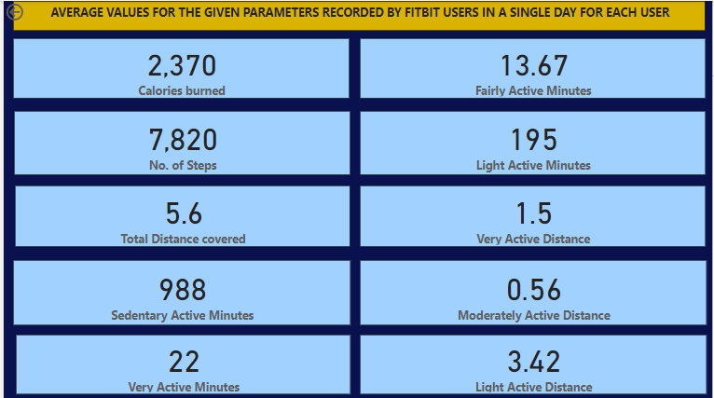

Slide 10
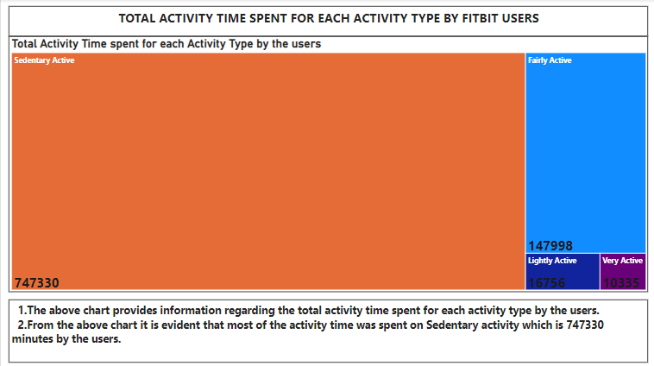

Slide 11
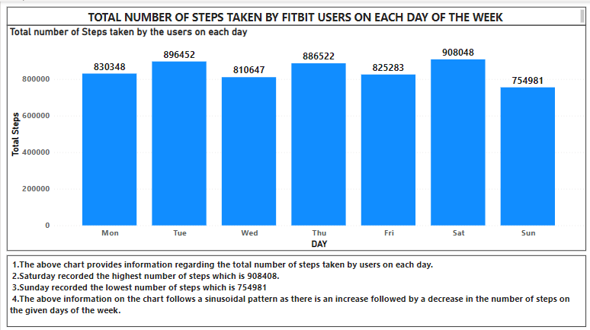

Slide 12
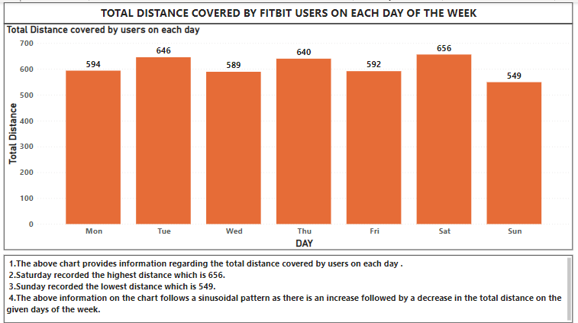

Slide 13
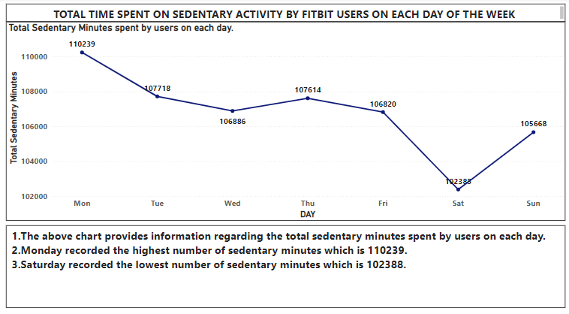

Slide 14
CONCLUSIONS
MOST OF THE ACTIVITY TIME WAS SPENT ON SEDENTARY ACTIVITIES WHICH SEEMS THAT THE USERS ARE FOLLOWING A SEDENTARY LIFESTYLE.
SATURDAY WAS THE MOST ACTIVE DAY OF THE WEEK IN TERMS OF MAXIMUM NUMBER OF STEPS TAKEN FOLLOWED BY MAXIMUM DISTANCE COVERED AND MINIMUM TIME SPENT ON SEDENTARY ACTIVITY.
SUNDAY WAS THE MOST LAZIEST DAY FOR THE USERS IN TERMS OF MINIMUM NUMBER OF STEPS FOLLOWED BY MINIMUM DISTANCE WHICH CONCLUDES THE FACT THAT THERE IS A POSITIVE CORRELATION BETWEEN NO.OF STEPS TAKEN AND THE DISTANCE COVERED.
FROM THE PREVIOUS 2 POINTS IT IS BETTER TO CONCLUDE THAT THERE IS A VARIATION IN THE ACTIVITIES OF THE USERS ON EACH DAY OF THE WEEK.
THE INSIGHTS OR CONCLUSIONS FROM THE ANALYSIS ARE WELL APPLICABLE TO WO BELLEBEAT PRODUCTS NAMELY:
1. LEAF
2. TIME

Slide 15
RECOMMENDATIONS
SOME OF THE FEATURES THAT CAN BE IMPLEMENTED IN THE BELLEBEAT PRODUCTS ARE AS FOLLOWS:
GET DETAILS REGARDING THE BMI OF THE USERS WHILE CREATING AN ACCOUNT WHICH WILL HELP IN ESTIMATING THE NO. OF STEPS TO BE TAKEN , NO. OF CALORIES TO BE CONSUMED AND BURNED ETC. FOR EACH DAY, WEEK OR MONTH.
PROVIDE SUGGESTIONS REGARDING THE DIET TYPE THAT THE PARTICULAR USER NEEDS TO FOLLOW TO MAINTAIN A HEALTHIER LIFESTYLE.
SEND NOTIFICATONS OR REMINDERS IF THE PARTICULAR USER HAS NOT COMPLETED OR FULFILLED THE REQUIRED QUANTITY OF THE PARAMETERS SUCH AS NO. OF STEPS, NO. OF CALORIES, ETC. OR IF THE PERSON HAS SPENT MORE TIME ON SEDENTARY ACTIVITIES IN ORDER FOR THE USERS TO BE AWARE OF THEIR DAILY ACTIVITIES.
PROVIDE SOME OFFERS ON ANNUAL SUBSCRIPTIONS AND IMPLEMENT POINT BASED SYSTEMS IN ORDER TO MOTIVATE USERS BY PROVIDING POINTS IF THEY HAVE ACHIEVED THEIR FITNESS GOAL AND THEN LATER THE USER CAN REDEEM THEIR POINTS IN ORDER TO BUY ANY PRODUCTS RELATED TO FITNESS ACTIVITIES OR SPORTS.
MARKET THE SPRING PRODUCT EXTENSIVELY IN ORDER TO GET THE HYDRATION LEVEL DETAILS OF USERS TO SUGGEST SOME MORE THINGS REGARDING HYDRATION WHICH CAN IMPACT THE HEALTH OF A PERSON.

